Slide 1
Simulation-based Evaluation of Post-Quantum Algorithm in TLS 1.3
Hyun-jun Kim, Si-woo Eum, Min-ho Song, and Hwa-jeong Seo

Slide 2
Motivation and Contribution
Motivation
Quantum computers pose a risk of breaking current cryptographic protocols.
There's an urgent need for quantum-resistant cryptographic algorithms.
Our research centers on integrating these new algorithms into the TLS 1.3 protocol.
TLS 1.3 is crucial for ensuring secure internet communications.
Contribution
We offer a detailed performance analysis of TLS 1.3 with PQC.
We use the NS-3 simulation tool for this analysis.
Our approach allows an in-depth examination of PQC methods in TLS 1.3.
We assess the impact of these methods in different network scenarios.

Slide 3
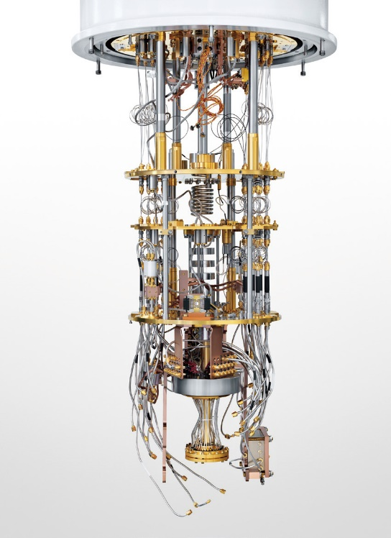
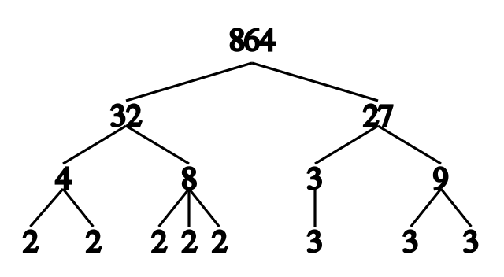
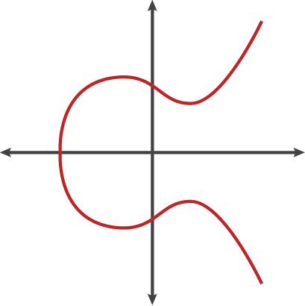

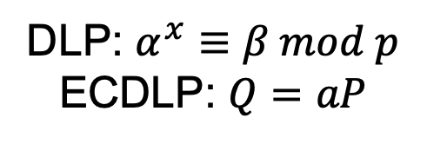
Migration from Legacy Cryptography to PQC
Shor’s Algorithm is an algorithm that performs factorization in polynomial time.
It renders current public key cryptography systems (RSA scheme, Finite Field Diffie-Hellman key exchange, Elliptic Curve Diffie-Hellman key exchange) ineffective.
Quantum computers are the only known attack platform capable of breaking modern cryptography in polynomial time.
There is a need for migration from legacy cryptography to secure PQC.
A stable 10,000 qubit quantum computer.
DLP: $α^{x}≡β mod p$
ECDLP: $Q=aP$
Shor’s Algorithm

Slide 4
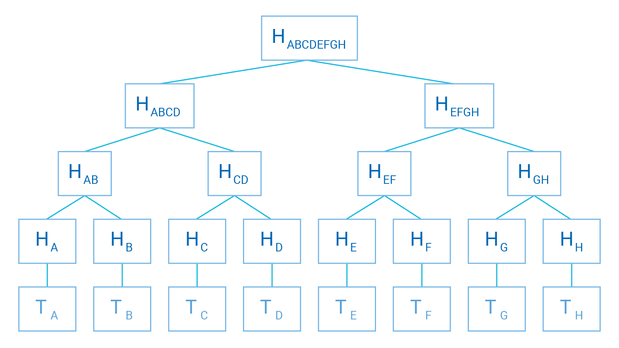
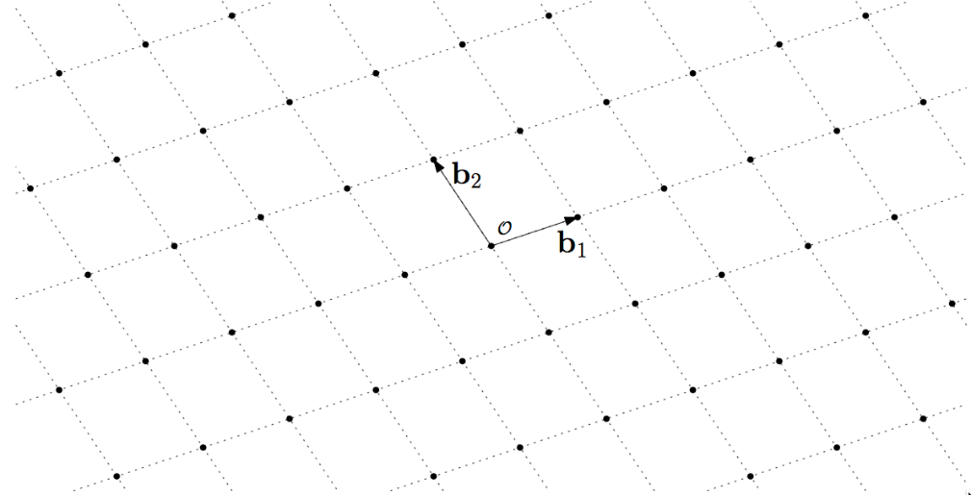
NIST PQC Standardization Process Algorithms
NIST Final selection PQC algorithms
Key exchange algorithms
CRYSTALS-KYBER
Signature algorithms
CRYSTALS-DILITHIUM
FALCON
SPHINCS+
Type | Description | Pros | Cons | Algorithms
Lattice | Lattice-based cryptography is a technique that includes errors in lattice operations to prevent hackers from identifying the actual secret key values. | Supports diverse applications, rapid implementation. | Difficulty in setting parameters | CRYSTALS-KYBER, CRYSTALS-DILITHIUM, FALCON
Hash | Hash-based cryptography is a cryptographic algorithm based on the safety of cryptographic hash functions, which have been researched for a very long time. | Provable security | Large signature size | SPHINCS+

Slide 5
NIST PQC Standardization Process Algorithms
NIST PQC Round 4 key exchange cryptographic algorithms
CRYSTALS-KYBER (Finalist)
A lattice-based cryptographic algorithm, known for its operational efficiency and shorter key length compared to code-based algorithms.
Classic McEliece (4th)
Based on Goppa codes and a variation of the original McEliece cryptosystem, it features large key sizes.
Among code-based ciphers, it demonstrates the fastest Encaps and Decaps performance, with the advantage of small ciphertext size, but the key generation process is slow.
BIKE (4th)
A code-based cryptographic algorithm that requires minimal memory.
Uses MDPC coding technique and is combined with bit flipping techniques for symmetric key exchange.
Slower in speed compared to Classic McEliece but has the advantage of shorter key length and consequently greater bandwidth.
HQC (4th)
A code-based cryptographic algorithm that reduces the size of the private key.
Uses MDPC coding and is combined with non-linear codes for public key encryption.
It has the advantage of using the shortest private key length among code-based ciphers but has the largest ciphertext size.
SIKE (4th)
An isogeny-based cryptographic algorithm. Recently discovered vulnerabilities have decreased its likelihood of being selected.

Slide 6
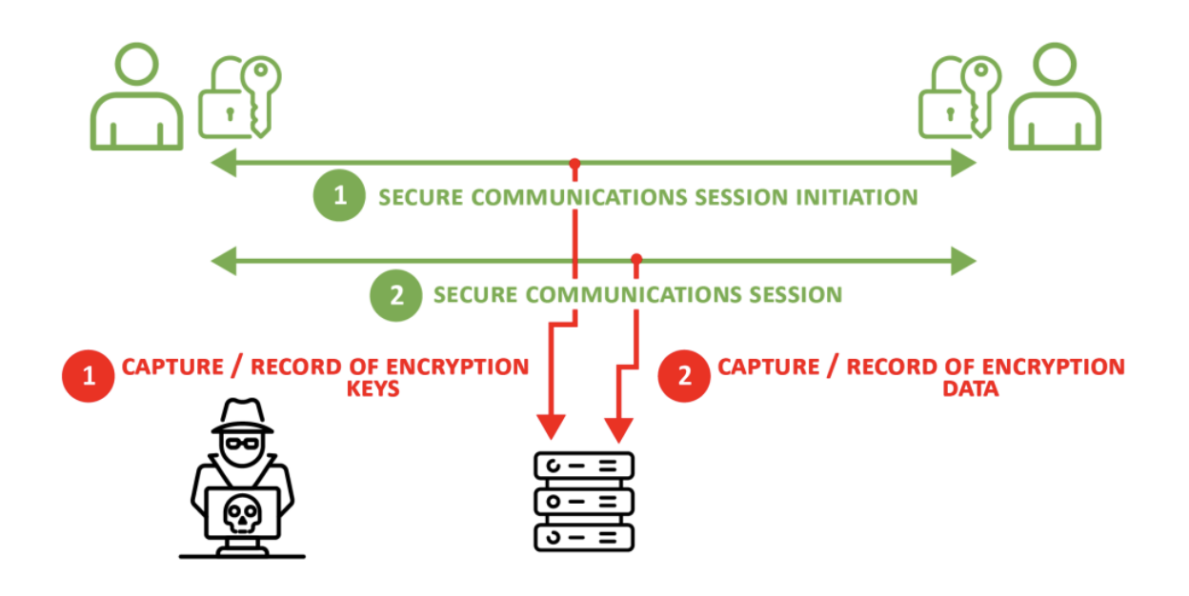
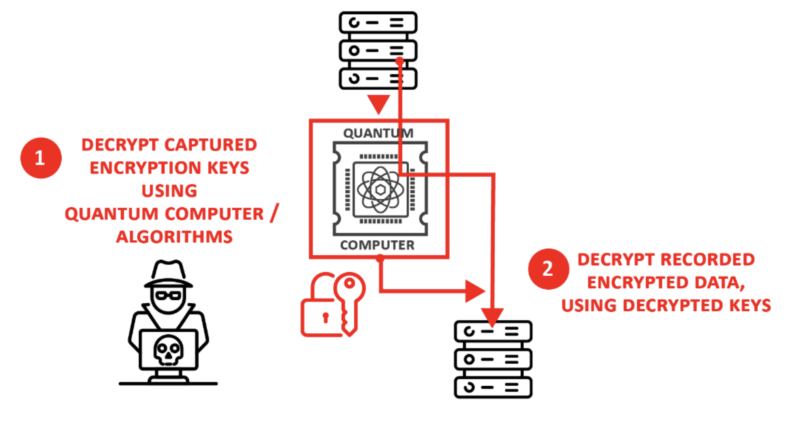
Security Risks from Delaying PQC Migration
Harvest Now Decrypt Later (HNDL) Attack
A technique of collecting encrypted data and analyzing it later when quantum computers are developed
Reasons for the Necessity of Transitioning to PQC Even in the Absence of Quantum Computers
Currently, the safety of encrypted data is assured as quantum computers do not exist
Once quantum computers emerge, it will be possible to decrypt (Decrypt Later) the previously captured encrypted data

Slide 7
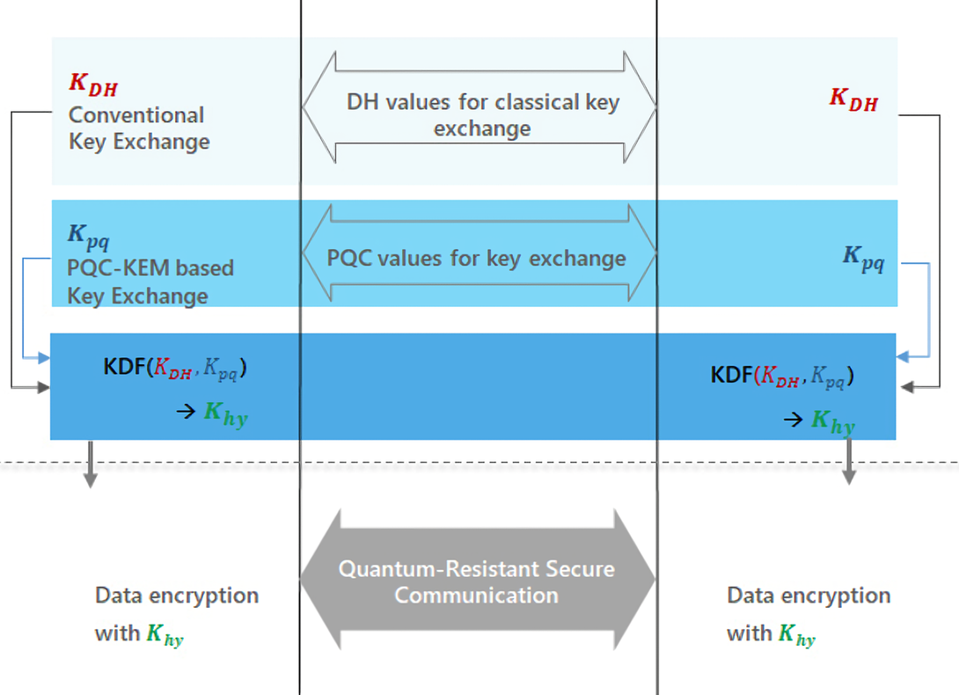
Hybrid key exchange
Using a key exchange algorithm based on two or more different cryptographic assumptions.
Ex)Using Elliptic Curve Diffie-Hellman and PQC (Post-Quantum Cryptography) algorithms.
Providing initial users with both traditional security and post-quantum security.
Maintaining existing cryptography while preparing for new post-quantum algorithms, given their relatively low trustworthiness.
Protecting the shared secret when at least one key exchange mechanism is secure.

Slide 8
Post-Quantum TLS 1.3
논문 | 대상 프로토콜 | 발표
QUIC Protocol with Post-quantum Authentication | QUIC | 2022
Fingerprinting Schemes against a Post-Quantum Cryptography IPsec/IKEv2 Encryption Appliance | IPsec/IKEv2 | 2022
Performance Evaluation of Post-Quantum TLS 1.3 on Resource-Constrained Embedded Systems | TLS1.3 | 2022
Post Quantum Cryptography Analysis of TLS Tunneling on a Constrained Device | TLS | 2022
Mixed certificate chains for the transition to post-quantum authentication in TLS 1.3 | TLS1.3 | 2021
Benchmarking Post-quantum Cryptography in TLS | TLS1.3 | 2020
Post-Quantum Authentication in TLS 1.3: A Performance Study | TLS1.3 | 2020
Post-Quantum TLS on Embedded Systems | TLS1.2 | 2020
Prototyping post-quantum and hybrid key exchange and authentication in TLS and SSH | TLS1.2-1.3, SSH | 2019
Post-Quantum Key Exchange for the Internet and the Open Quantum Safe Project | TLS1.2 | 2017
Active research is ongoing in integrating major protocols (TLS) with the NIST PQC Competition.
For TLS, a "hybrid" approach is proposed for reasons such as maintaining compliance with outdated industry or government regulations.
TLS has undergone extensive research, and recently, research on other protocols (SSH, QUIC, IPsec/IKEv2) is also progressing.

Slide 9
Simulation Environment Analysis for Migrating to TLS 1.3 PQC
TLS 1.3 PQC Migration Analysis
Focusing on the NIST-PQC finalists and Round 4 candidates
Conducting tests for the reimplementation and detailed analysis of various cases
Simulation Environment Testing
Setting up a test environment based on OQS OpenSSL and NS-3 To enable testing of various protocols under different constraints.
Network Simulation Environment
Conducting Point-to-Point network simulations
Performance in networks with fixed bandwidth and latency
Using a standard 1,500-byte MTU
Occurrence of TCP fragmentation due to large certificate sizes and key sizes in PQC
Potential impact of network latency (delay)
Experiments conducted with added network delays of 5ms, 100ms, and 200ms for measurement
PC : Intel(R) Core(TM) i5-8259U CPU @ 2.30GHz, Ubuntu
Protocols
PQC Only, hybrid (PQC + ECC)

Slide 10
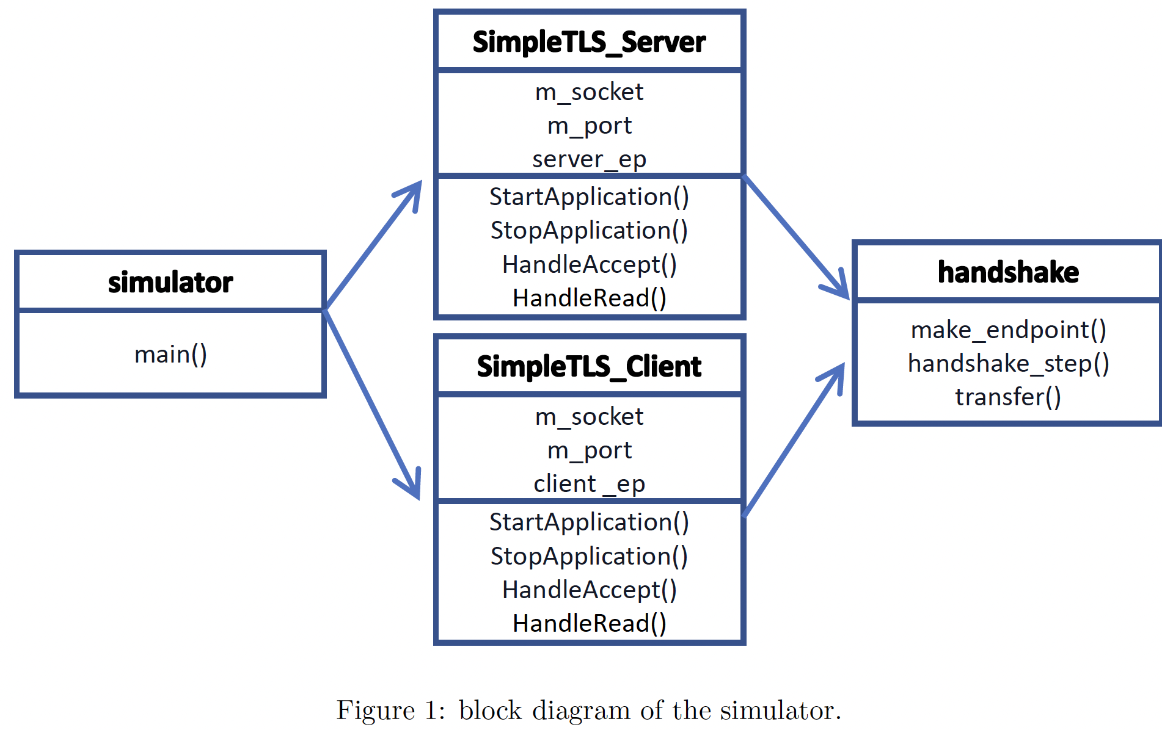
Simulator Environment Configuration
OQS
OQS focuses on quantum-resistant cryptographic algorithms for network security.
Includes liboqs, a library for quantum-safe encryption, and a fork of OpenSSL.
NS-3 Simulator
NS-3 is a widely-used network simulator for research and development.
Features a modular design for simulating various network protocols and behaviors.
Simulator Implementation
Built on NS-3 and OQS OpenSSL.
Models client-server communication with TLS encryption.
`SimpleTLSServer : Server Role Class Using TLS.
‘SimpleTLSClient’ : Client Role Class Using TLS
The `handshake` process manages TLS endpoints and SSL handshakes.

Slide 11
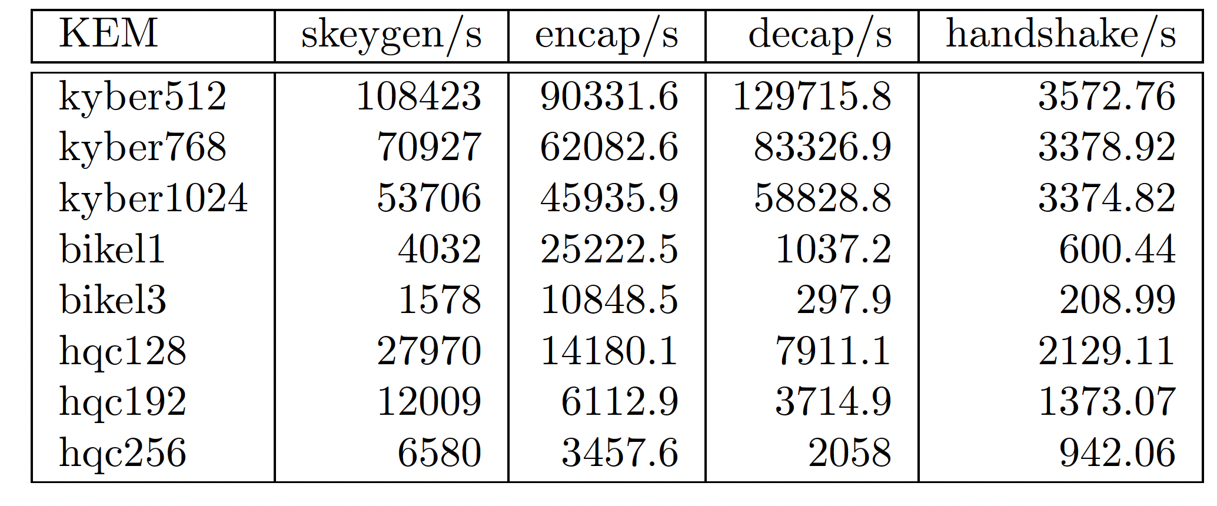
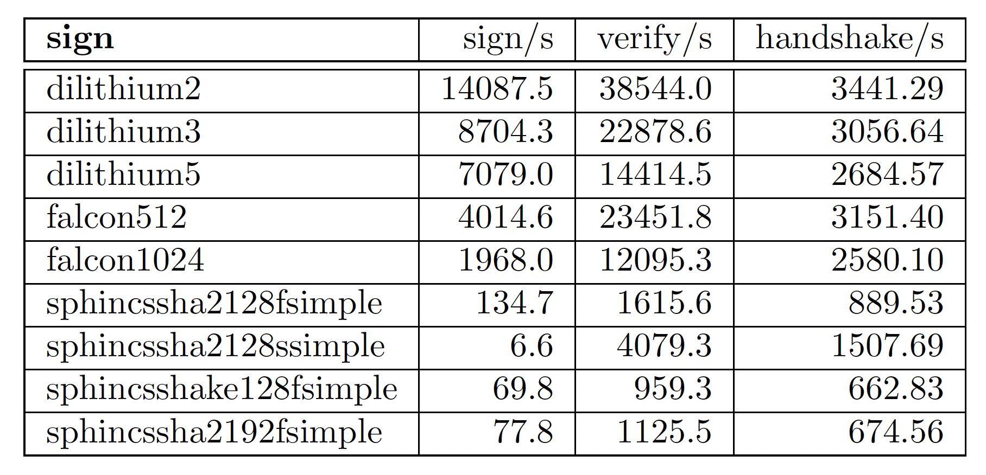
Local testing using OpenSSL
Among KEM algorithms, Kyber versions (512, 768, 1024) performed best.
BIKE and HQC algorithms had comparatively lower performance.
In signature algorithms, Dilithium and Falcon were high-performing.
SPHINCS showed the lowest performance in signature algorithms.
The combination of Kyber512 KEM and Dilithium2 signature algorithm achieved the best handshake performance.

Slide 12
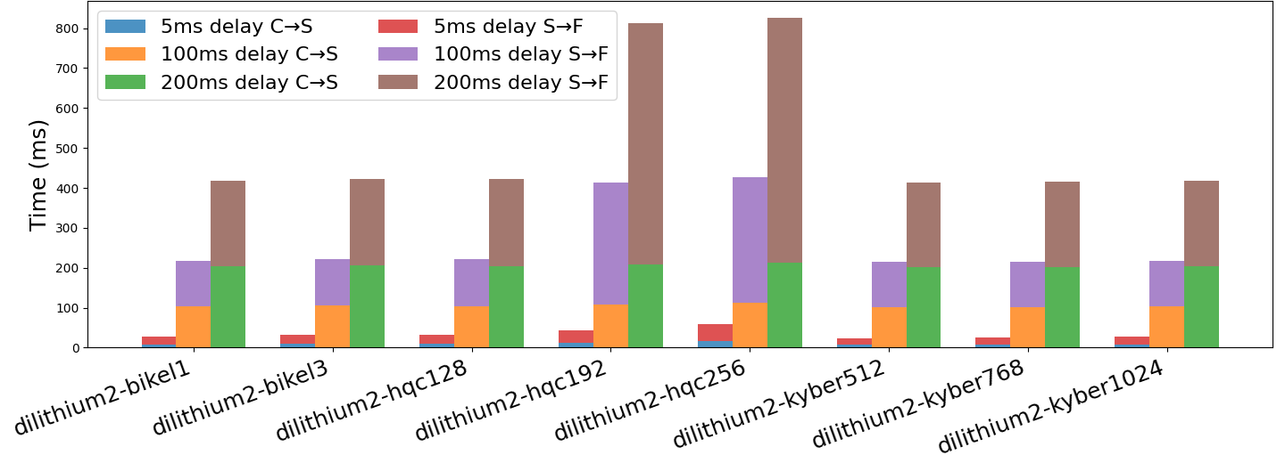
Point-to-Point network Simulation KEM
The time between sending Client hello and Server hello messages is generally consistent.
However, the time from Server hello to the completion message varies greatly with different signature and KEM schemes.
KYBER > BIKE > HQC Kyber shows the best performance.
Performance decreases with increasing cryptographic strength, especially noticeable in HQC-192 and HQC-256.

Slide 13
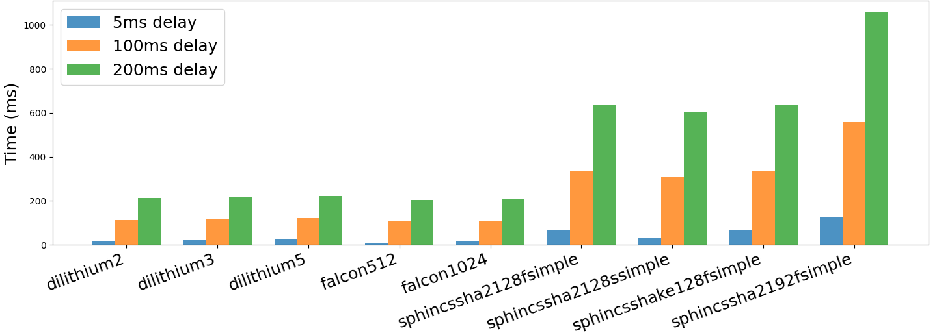
Point-to-Point network Simulation SIG
Falcon > Dilithium > Sphincs+ Falcon generally performs better in terms of time compared to Dilithium.
Generally, larger key sizes and ciphertext sizes are associated with longer transmission and processing times.
SPHINCS variants take the longest time despite not having the largest size.

Slide 14
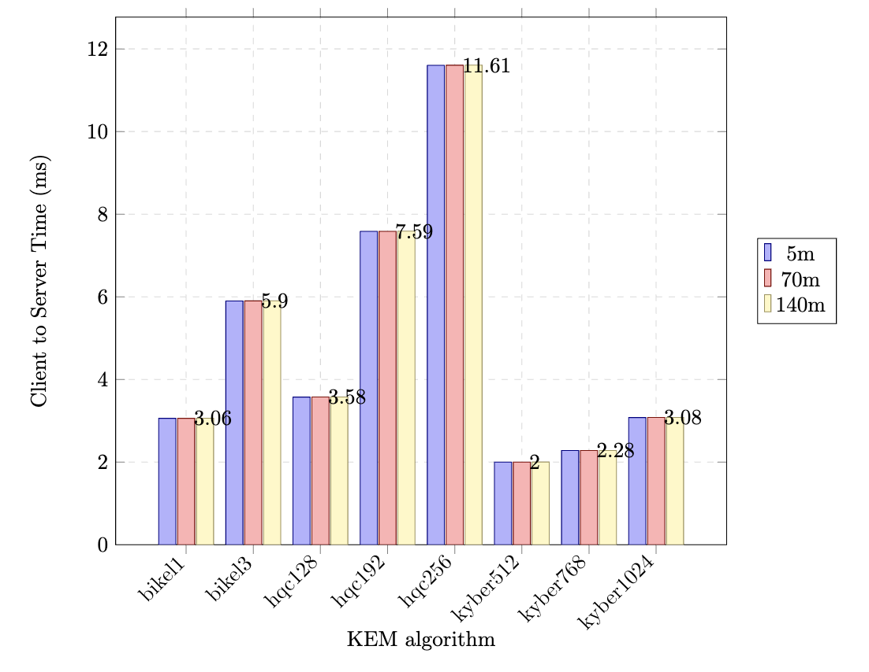
Wi-Fi network Simulation
In the Wi-Fi network simulation:
Measurements were conducted at different distances.
Results were consistent with the Point-to-Point simulations.
Delays were negligible, even at the maximum tested distances.

Slide 15
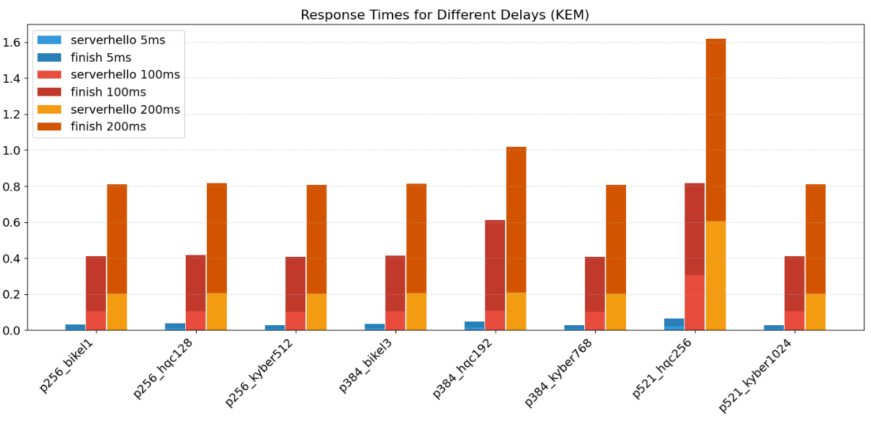
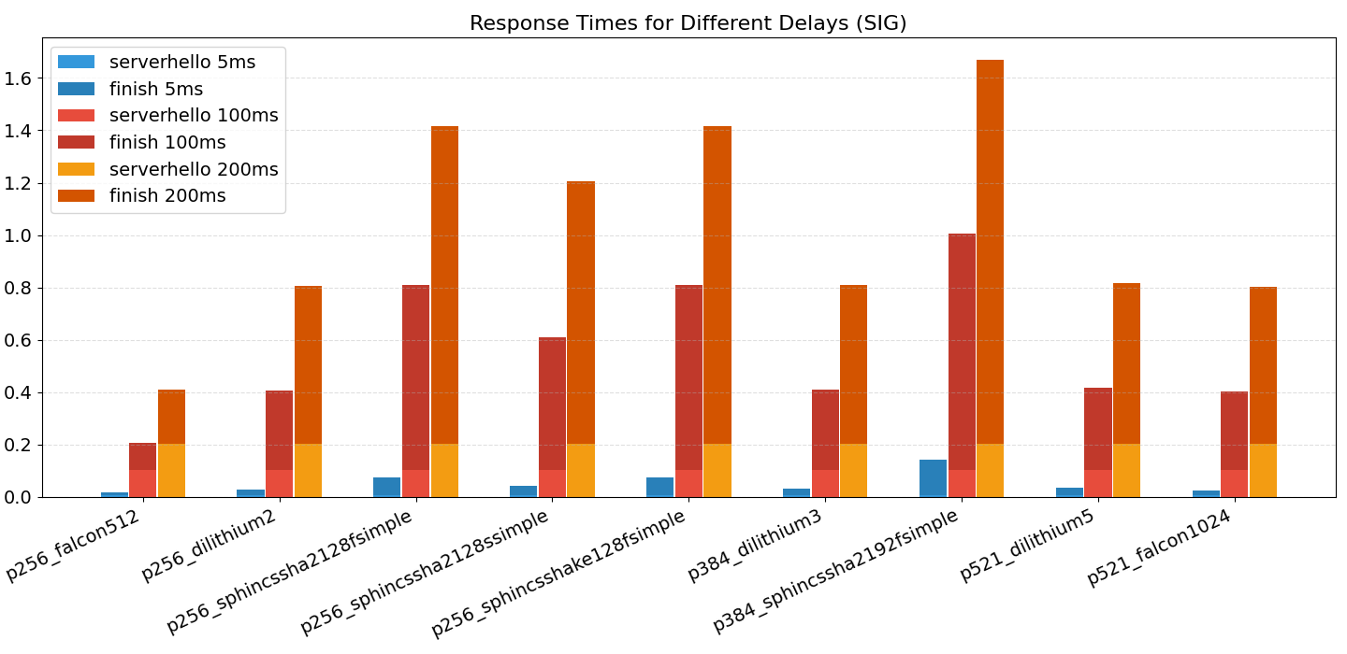
Hybrid key exchange comparison
KYBER and Falcon algorithms consistently outperform others, like SPHINCS and HQC, in hybrid scenarios.
It's crucial to carefully choose a mix of traditional and post-quantum algorithms.
This selection helps balance security and performance in real-world situations.
Security level | KEM |  | SIG
L1/L2 | p256 | BIKE-L1, HQC-128, Kyber512 | p256 | Falcon-512, SPHINCS+ 128 / Dilithium2
L3 | p384 | BIKE-L3, HQC-192, Kyber768 | p384 | Dilithium3, SPHINCS+ 192
L5 | p521 | BIKE-L5, HQC-256, Kyber1024 | p521 | Falcon-1024(L5), Dilithium5, SPHINCS+ 256
L5
L1/L2
L3
L5
L1
L3

Slide 16
Conclusion and Future work
In this study, we used NS-3 to evaluate the impact of quantum-resistant cryptography on TLS 1.3 under various network conditions in a controlled environment.
The research focused on NIST PQC algorithms and 4th round candidates, reflecting the current hybrid approach in TLS.
Factors like key size and algorithm efficiency affected transmission and processing times.
Delays occurred particularly when packets were fragmented due to exceeding the Maximum Transmission Unit (MTU) size.
Future research will explore the performance of hybrid solutions, considering different network scenarios and energy consumption.

